Slide 1
Course Code:CSC402A Course Title: Web Architecture and Application Development
Course Leader:
Kishore S.M.
kishore.cs.et@msruas.ac.in

Slide 2
Objectives
After completing this lecture, the student will be able to
Describe SOA
Analyze SOA architecture
Analyze SOA implementation

Slide 3
Contents
SOA
SOA Architecture
Services
Service implementation

Slide 4
Service Oriented Architecture
SOA presents a new method to create distributed applications where basic services can be published, discovered and bound together
It builds more complex composed services representing greater added value
Applications interact with services through an interface endpoint and not at the implementation level
It is possible to obtain a maximal return on the investment by providing reusable and interoperable services

Slide 5
Service Oriented Computing
It builds upon past distributed computing platforms and adds new design layers, governance considerations, and a vast set of preferred implementation technologies
Example for Service
Weather Services, which can be used to get the weather information
Any application on the network can use the service of the Weather Service to get the weather information

Slide 6
Software Architecture
Software architecture
A set of statements that describe software components and assigns the functionality of the system to these components
Two common elements
The highest-level breakdown of a system into its parts
These components are intended to be flexible building blocks
Decisions that are hard to change
It describes the technical structure, constraints, and characteristics of the components and the interfaces between them
The architecture is the blueprint for the system

Slide 7
Service Oriented Architecture
It’s an approach that helps systems remain scalable and flexible while growing, and that also helps bridge the business/IT gap
You might call it a style, paradigm, concept, perspective, philosophy, or representation
SOA is a concept not bound to any specific technology or platform
You can't buy SOA
SOA enables incremental development, deployment, and maintenance
Companies can use the existing software (investments) and use SOA to build applications without replacing existing applications

Slide 8
SOA - Definition
Definition
SOA is an architectural paradigm for dealing with business processes distributed over a large landscape of existing and new heterogeneous systems that are under the control of different owners

Slide 9
Service Oriented Architecture
Efficient for
Large systems
Distributed systems
Systems of systems
Inefficient for
Small – medium sized systems
Non-distributed systems

Slide 10
Operations in a SOA
Publish
To be accessible, a service description must be published so that it can be discovered and invoked by a service consumer
Find
A service requestor locates a service by querying the service registry for a service that meets its criteria
Bind and invoke
After retrieving the service description, the service consumer proceeds to invoke the service according to the information in the service description

Slide 11
Service Oriented Architecture
A Service Oriented Architecture (SOA) is a software architecture that is based on the key concepts of
An application frontend
Service
Service repository
Service bus

Slide 12
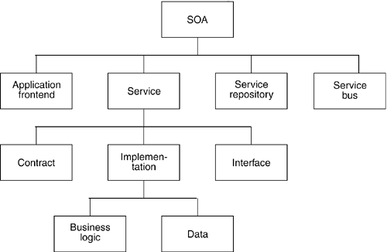
Service Oriented Architecture

Slide 13
Service Oriented Architecture
Application frontend
Services
Provide business functionality that the application frontends and other services can use
Service repository
Stores the service contracts of the individual services of an SOA
Service bus
Interconnects the application frontends and services

Slide 14
Services
A service consists of
A service contract
Specifies the functionality, usage, and constraints for a client of the service
An implementation
Provides business logic and data
A service interface
Physically exposes the functionality

Slide 15
Application Frontends
They initiate and control all activity of the enterprise systems
It is always an application frontend that initiates a business process and receives the results
There are different types of application frontends
E.g., An application frontend with a graphical user interface, such as a Web application or a rich client that interacts directly with end users
They do not necessarily have to interact directly with end users
Batch programs or long-living processes that invoke functionality periodically or as a result of specific events
They are similar to the upper layers of traditional multilayer applications

Slide 16
Services
A service is a software component of distinctive functional meaning that typically encapsulates a high-level business concept
The functionality might be
Simple
E.g., create a customer account, get a customer’s contracts, transfer money, turn on the radio, etc.,
Complex
E.g., a business process for a customer’s order, loan Processing Services
Services bridge the business/IT gap
They concentrate on the business value of an interface

Slide 17
Service Contract
Provides an informal specification of the purpose, functionality, constraints, and usage of the service
The form of this specification can vary, depending on the type of service
One non-mandatory element is a formal interface definition based on languages such as IDL or WSDL
It provides further abstraction and independence of technology, including programming language, middleware, network protocol, and runtime environment
The contract can impose detailed semantics on the functionality and parameters that is not subject to IDL or WSDL specifications

Slide 18
Service Interface
The functionality of the service is exposed by the service interface to clients that are connected to the service using a network
The description of the interface is part of the service contract
The physical implementation of the interface consists of service stubs, which are incorporated into the clients of a service and dispatcher

Slide 19
Service Implementation
It is the technical realization that fulfills the service contract
Consists of one or more artifacts such as programs, configuration data, and databases
Business logic
The business logic that is encapsulated by a service is part of its implementation
It is made available through service interfaces
Data
A service can also include data
It is the purpose of a data-centric service

Slide 20
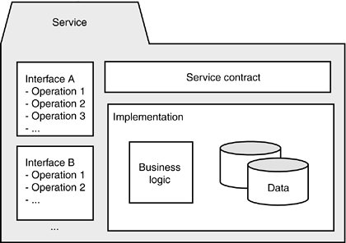
Service Implementation

Slide 21
Service Repository
A service repository provides
Facilities to discover services
Acquire all information to use the services particularly if these services must be discovered outside the functional and temporal scope of the project that created them
Provides additional information like
Physical location
Information about the provider
Contact persons
Usage fees
Technical constraints
Security issues

Slide 22
Service Repository contd.
Examples of information that should be contained in an enterprise-wide service repository
Service, operation, and arguments signatures, such as in the form of WSDL and XML Schema definitions
Service owner - In an Enterprise SOA, owners can operate at the business level, development level, and operations level
Access rights, such as information about access control lists and the underlying security mechanism
Information about the intended performance and scalability of the service, including average response times, and potential throughput limitations
Transactional properties of the service and its individual operations

Slide 23
Summary
SOA is an approach that helps systems remain scalable and flexible while growing, and that also helps bridge the business/IT gap
A service is a software component of distinctive functional meaning that typically encapsulates a high-level business concept

